Slide 1
Power of Python!
Unit 3.1
Cybersecurity Boot Camp |

Slide 2
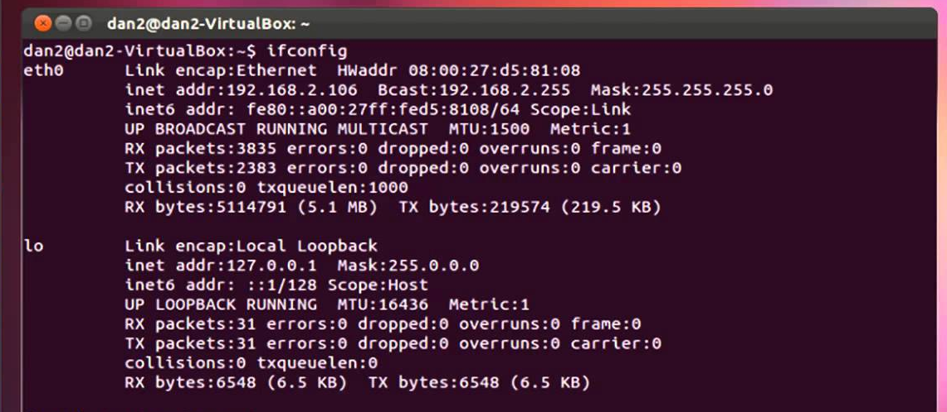
Last Week…
Last week, we got our hands dirty with the command line.

Slide 3

This Week: Enter Python
This week, we will expand our toolset by introducing the Python programming language.

Slide 4
Today’s Goals
By the end of class, you will be able to:
Explain how and why Python is used in cybersecurity.
Create and run Python files via the terminal using VS Code
Use the print() function to print lines to the console.
Use basic Python elements like variables and operators.
Employ the Python input() function to retrieve, store, and utilize user inputs.
Reference and store collections of data using lists.
Create and reference data in dictionaries.

Slide 5
Why Python?

Slide 6

Quick Fist to Five!
Raise a Fist If you’ve never worked with Python and barely know what it is.
Raise a Five If you work with Python on a daily basis.
Raise a One, Two, Three, or Four
If you fall somewhere in between.

Slide 7
Quick Fist to Five!
Story Time
For those of you who have used Python, where have you used it and what for?

Slide 8
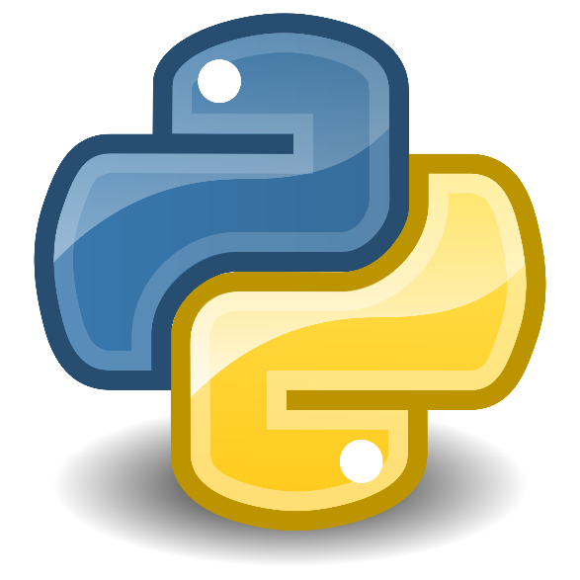
What Is Python?
Python is a high-level, general purpose programming language used for a variety of applications.
It has an enormous community of developers.
It is used in a wide variety of industries and jobs.
Prioritizes readability for ease of use.
Notes:
Python forces you to follow certain rules to make the code readable. Well written code makes it easier for everyone to read, which makes team collaboration easier.

Slide 9


Bash Verses Python
Bash/Shell Scripts/Unix are great for OS-level interaction, dealing with processes, and interacting with the file system.
Python is great for simple or complex logic-based applications, and for automating complex tasks.
In reality, we’ll use both Python and Bash. Python allows us to write complex applications and do logic with relative ease, but the terminal is indispensable for OS and file system interaction.

Slide 10
Why Learn Python?
As security professionals, Python:
Can be used for a huge set of tasks. For example, automation of repetitive tasks, network emulation, cloud computing, cryptography, analytics, forensics, malware detection, visualization, and more.
Is often the simplest way to solve a problem. With powerful tools and syntax, Python can speed up processes that require significant manual effort. While the learning curve can be tough, it’s one of the simplest and well-supported programming languages.
Has tons of community support and already-written code. The Python community has shared a huge number of tools and modules that we can use to help us quickly solve complex problems.

Slide 11
Why Learn Python?
Learning Python is a huge competitive advantage for technically oriented cybersecurity jobs.
Skill | Number of Job Listings
Information Security | 151,470
Linux | 73,735
Project Management | 69,072
Network Security | 63,519
Cryptography | 53,997
Network Engineering | 47,651
SQL | 43,651
Unix | 40,945
Python | 40,750
Based on national job listings in the cybersecurity through 2017. (Source: Burning Glass)

Slide 12
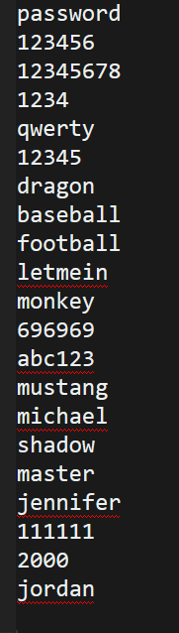
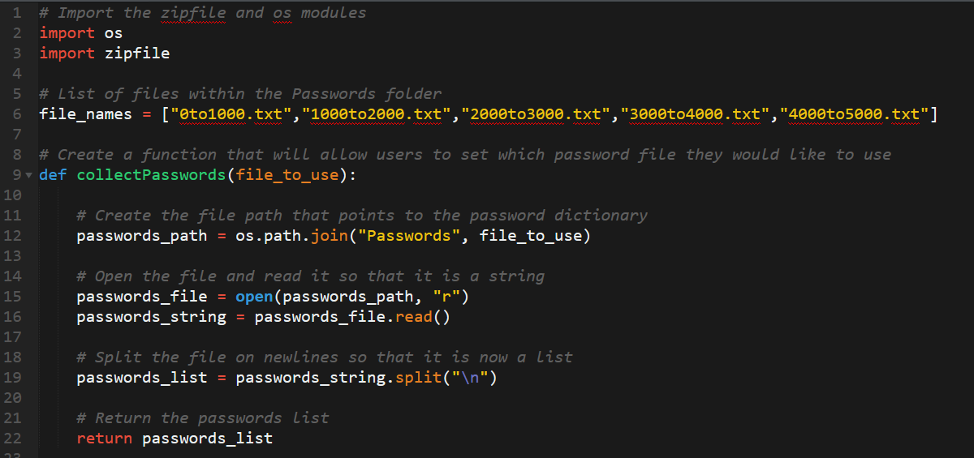
Example Application: Password Cracker
We’ll learn to write Python code that breaks into password-encrypted files using a brute-force algorithm that checks tens of thousands of common passwords.

Slide 13
Today’s Goals
Let’s check-in on today’s goals! Any questions?
Explain how and why Python is used in cybersecurity.
Create and run Python files via the terminal using VS Code
Use the print() function to print lines to the console.
Use basic Python elements like variables and operators.
Employ the Python input() function to retrieve, store, and utilize user inputs.
Reference and store collections of data using lists.
Create and reference data in dictionaries.

Slide 14
Setup Time!

Slide 15

Python and VS Code
Python
VS Code
Python is the programming language.
VS Code is the editor in which we’ll write the code.

Slide 16
Activity: Install Python (15 min)
Check to see if you have Python installed. Follow these steps:
Open a terminal (or Git Bash) window.
Then enter the command: python –version (Windows) or python3 –version (Mac).
If Python 3.x.x is returned then you have the correction version installed. (If you see the phrase Python 2.x.x (or receive an error), install Python using the steps below).
To install Python, follow these steps:
Navigate to the Python website and download the latest version. (https://www.python.org/downloads/)
Complete the default installation steps. (Important! Windows users must select the Add Python 3.x to PATH option from the Install Python dialog).
Check that you have the latest version of Python installed again by opening a terminal or Git Bash window and entering the python --version (Windows) or python3 --version (Mac) command.
Notes:
You and your TAs should be ready to help students troubleshoot installation issues.
Some students may need to run the echo "alias python=python3" >> ~/.bashrc command and then restart the terminal (if they are getting a "The program 'python' is not installed" error).
Then reopen the terminal (or Git Bash) window and run the commands:
Windows: echo "alias python=python3" >> ~/.bashrc
Mac: python3 (You will run python with this command going forward)

Slide 17
Activity: Install VS Code (5 min)
VS Code is the editor we will use to write our code, if you don’t have it installed yet, install it now.
To install VS Code:
Go to this page https://code.visualstudio.com/ to download and install VS Code.
Open VS Code and click the Extensions icon in the Activity bar.
In the search bar, type Python and download the first extension that appears.

Slide 18
Hello World!
Instructor Demo

Slide 19
Activity: Goodnight World (7 min)
Instructions:
Create a new file in VS Code and save it as GoodnightWorld.py
Write a line of code that will print out the line "Goodnight World!" to the terminal when run.
Go to the folder where you saved GoodnightWorld.py and run the application.
Tips: The print() function allows you to print lines to the console.
Remember to put the phrase in quotes so that it prints properly.

Slide 20
Today’s Goals
Let’s check-in on today’s goals! Any questions?
Explain how and why Python is used in cybersecurity.
Create and run Python files via the terminal using VS Code
Use the print() function to print lines to the console.
Use basic Python elements like variables and operators.
Employ the Python input() function to retrieve, store, and utilize user inputs.
Reference and store collections of data using lists.
Create and reference data in dictionaries.

Slide 21
Programming Fundamentals

Slide 22
Programming Fundamentals
Programming is just piecing logic together to solve larger problems and produce output.
All of programming is basically just manipulating data.
Data
Numbers
Strings
Booleans
Lists
Dictionaries
Logic
Operators
Conditionals
Loops
Functions
Modules

Slide 23
Variables
Variables are the means by which we can store and reference data. We assign values to variables in Python.
The assignment statement:
Variable Name
Assignment Operator
Value
name
=
“Fa Mulan”
The quotes (“”),
convey that “Fa Mulan” is a string.

Slide 24
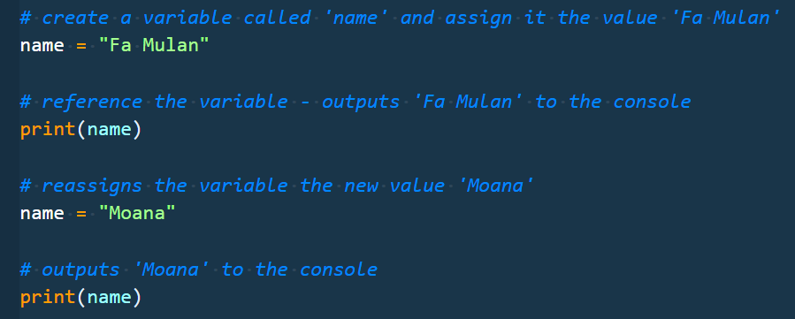
Variables
Variables that have been assigned can then be referenced and reassigned in the code later, as shown in the following image:
Notes:
Explain that print allows you to output something to the console.

Slide 25

Integers and Floats
49
6.38
Integers
Floats

Slide 26
Strings
“Hello World!”
“13 peas, please.”
“#@$^!”
“Strings are any collection of characters.”

Slide 27
Booleans
true
false
Booleans can only have the value TRUE or FALSE.

Slide 28
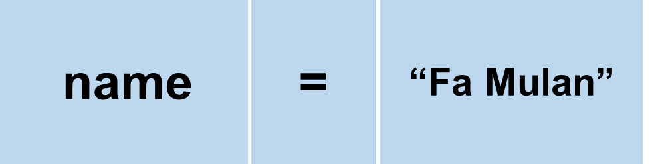
Operators
Operators are symbols that do something with data.
We’ve already seen an operation! The assignment operator = stores a value to a variable
There are many more! For example:
Arithmetic: +, -, *, /, etc.
Comparison: <, >, ==, !=, etc.
Logical: and, or, not
Too many to go into all of them right now!
Notes:
https://data-flair.training/blogs/python-operator/
https://docs.python.org/3/reference/expressions.html

Slide 29
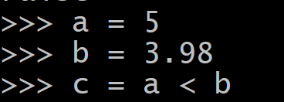
Let’s Review
What are variables?
Why use variables?
Let’s define following data types:
Integers
Floats
Boolean
What are operators?
Examples!
What is the value and data type of c in the example below?

Slide 30
Variable Dissection
Instructor Demo

Slide 31
Activity: Variable Addresses (12 min)
In this activity, you will create some variables for a website and its daily hits in order to print out a summary of this information to the screen. Follow these steps:
Create a variable called URL which will contain a URL in string form.
Create a variable called IP_address which will contain an IP address in string form.
Create a new variable for each weekday and, using integers, set them equal to how many hits the site got on those days. Note: You can choose an arbitrary number for each.
Create a variable called weekly_hits and set it equal to the sum of the hits on each day of the week.
Create a variable called average_hits which takes the weekly_hits and divides it by the number of weekdays in a week.
Print out each variable to the terminal.

Slide 32
Variable Addresses
Instructor Review

Slide 33
Today’s Goals
Let’s check-in on today’s goals! Any questions?
Explain how and why Python is used in cybersecurity.
Create and run Python files via the terminal using VS Code
Use the print() function to print lines to the console.
Use basic Python elements like variables and operators.
Employ the Python input() function to retrieve, store, and utilize user inputs.
Reference and store collections of data using lists.
Create and reference data in dictionaries.
Notes:
Review goals; address any questions.

Slide 34
User Input

Slide 35
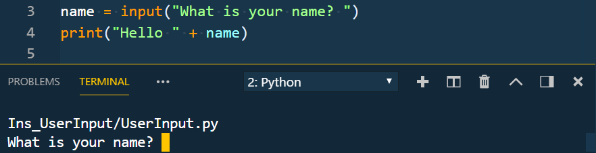
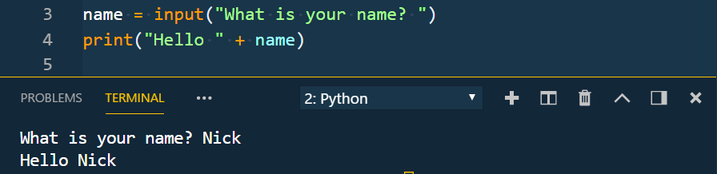
User Input
To get input from the user in Python, you use input() and store the result to a variable.
input waits to execute any code following it until after the user has entered a value.
The value always comes back as a string (so you may need to convert it).
Notes:
Review goals; address any questions.

Slide 36
Input Demo
Instructor Demo

Slide 37
Activity: Down to Input (10 min)
You will create an application by gathering information from your neighbor and then running some code.
Follow these steps:
Create two different variables, user_name and neighbors_name, that will take the input of your first name and your neighbor's first name.
Create two more variables, months_you_coded and months_neighbor_coded, that will take the input of how many months each of you have been coding.
Create another variable, months_neighbor_coded that combines the total number of months that each of you have been coding.
Print out the following two statements:
The first should say I am [user_name] and my neighbor is [neighbor_name].
The second should say Together we have been coded for total_months_coded.
Example: “My name is Nick and my neighbor’s name is Jacob. Together we have been coding for 204 months!”
Notes:
Students should work alone. Have them get the user input from their neighbor and then proceed with the activity.

Slide 38
Down to Input
Instructor Review
Notes:
Review goals; address any questions.

Slide 39
Today’s Goals
Let’s check-in on today’s goals! Any questions?
Explain how and why Python is used in cybersecurity.
Create and run Python files via the terminal using VS Code
Use the print() function to print lines to the console.
Use basic Python elements like variables and operators.
Employ the Python input() function to retrieve, store, and utilize user inputs.
Reference and store collections of data using lists.
Create and reference data in dictionaries.
Notes:
Review goals; address any questions.

Slide 40
Break!

Slide 41
Lists

Slide 42
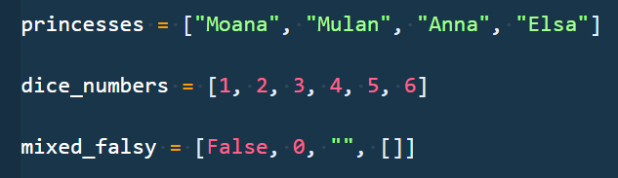
Lists
Lists are collections of data.
These collections can be made up of strings, numbers, Booleans, other arrays, dictionaries . . . anything.
They typically denote related data, e.g. student names, devices connected to network, etc.
Notes:
Review goals; address any questions.

Slide 43
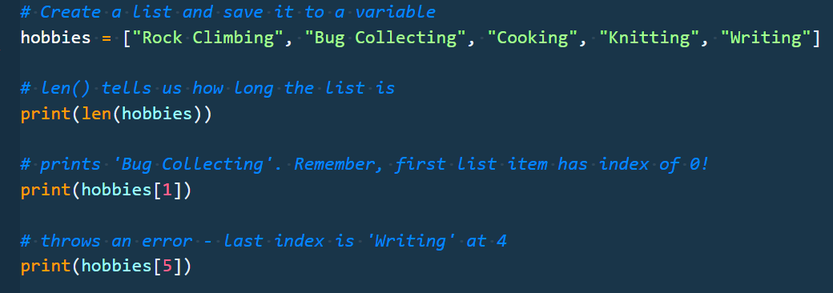
Lists
Each element of the array is marked by an index. Indexes always start at 0.
To reference the value at a specific index you include the name of the list with a square bracket [ ]. Inside the bracket you use the element’s index.
Notes:
Review goals; address any questions.

Slide 44
Lists
List Name: zoo_animals
Zebra
Rhino
Giraffe
Owl
Index 0
Index 1
Index 2
Index 3
Notes:
Review goals; address any questions.

Slide 45

Lists
List Name: zoo_animals
Zebra
Rhino
Giraffe
Owl
Index 0
Index 1
Index 2
Index 3
Coded in Python using a List
Notes:
Review goals; address any questions.

Slide 46
Intro to Lists
Instructor Demo

Slide 47
Activity: Messy Lists (15 min)
You have been given a large list of IP addresses and will answer some basic questions based on its contents. Afterwards, they will add and remove IP addresses to and from the list.
Follow these steps:
Determine the length of the list and print the length out to the terminal.
Determine indexes for the IPs "82.82.0.22" and "207.209.106.220" and then print them out to the terminal.
Add the following IP addresses to the list:
220.66.146.40
245.201.208.161
208.222.148.199
104.216.140.187
73.57.167.115
Remove the following IP addresses from the list:
53.239.114.76
65.136.121.223

Slide 48
Messy Lists
Instructor Review
Notes:
Review goals; address any questions.

Slide 49
Today’s Goals
Let’s check-in on today’s goals! Any questions?
Explain how and why Python is used in cybersecurity.
Create and run Python files via the terminal using VS Code
Use the print() function to print lines to the console.
Use basic Python elements like variables and operators.
Employ the Python input() function to retrieve, store, and utilize user inputs.
Reference and store collections of data using lists.
Create and reference data in dictionaries.
Notes:
Review goals; address any questions.

Slide 50
Dictionaries

Slide 51


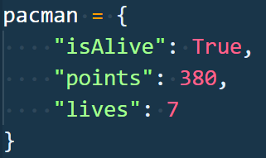
Dictionaries
Dictionaries store data in key-value pairings where the key is a string that can be referenced in order to collect the value that is associated with it.
isAlive: True
points: 380
lives: 7
Notes:
Review goals; address any questions.

Slide 52
Dictionaries: Creation
A dictionary is a mapping of keys to values.
You use curly braces, { }, to construct the dictionary
Values can be any Python value
Keys are more limited and are typically strings.
Values (Booleans, numbers, strings, etc.)
keys (strings)
Notes:
Review goals; address any questions.

Slide 53
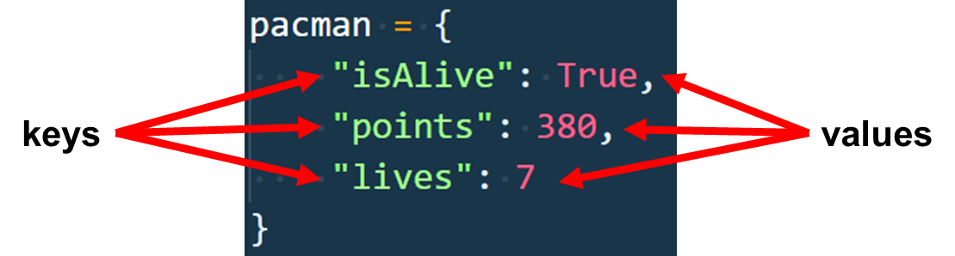
Dictionaries: Referencing
Referencing values in a dictionary is similar to lists. Instead of using a number index, you use the key value. Both use square brackets:
pacman["isAlive"] evaluates to True
pacman["points"] evaluates to 380
Notes:
Review goals; address any questions.

Slide 54
Dictionaries
Instructor Demo

Slide 55
Activity: Hobby Book (15 min)
Instructions:
Create a dictionary that will store the following:
Your name
Your age
A list of a few of your hobbies
A dictionary of the times you wake up on weekdays and weekends.
Print out three statements:
Hello I am (name) and I am a (occupation)
I have (number of) hobbies!
On the weekend I get up at (time)

Slide 56
Hobby Book Dictionary
Instructor Review
Notes:
Review goals; address any questions.

Slide 57
Today’s Goals
Let’s check-in on today’s goals! Any questions?
Explain how and why Python is used in cybersecurity.
Create and run Python files via the terminal using VS Code
Use the print() function to print lines to the console.
Use basic Python elements like variables and operators.
Employ the Python input() function to retrieve, store, and utilize user inputs.
Reference and store collections of data using lists.
Create and reference data in dictionaries.
Notes:
Review goals; address any questions.

Slide 58
Lesson Recap

Slide 59
Python Learning Tips
Review Immediately We’ll be building on these concepts quickly. The firmer your grasp now, the better off you’ll be.
Redo the exercises from class Don’t just reread! Spend some time redoing the activities from scratch on your own.
Get Help Come to office hours. Ask conceptual questions. Ask specific questions. Just keep asking questions!
Don’t Be Afraid You will get this. It will take time, but you will get this. Keep at it. Patience will pay off.
Practice Practice Practice Only by doing will you learn how to code—reading code and reviewing helps, but writing code is the best way to succeed.
Notes:
What to work on at home before the next class!

Slide 60
Today’s Summary
Variable Assignment and Reference
name = "Nick", print(name)
Data Types and Conversion (Number, String, Boolean)
str(), int()
Operators (Arithmetic, Comparison, etc.)
+, -, *, =, ==, !=, >, in, and, etc.
Lists
arr = ["a", "b", "c"]
arr[1]
len(), append(), etc.
Dictionaries
arr = {"a":"b", "c":"d"}
User Input
input()
Tip: We covered a lot today!
But there’s plenty more to come. Be sure to spend time before next class, redoing today’s exercises to build proficiency (and maybe attempting the bonuses!).
Notes:
Review goals; address any questions.

Slide 61
Today’s Summary
Data
Numbers
Strings
Booleans
Lists
Dictionaries
Logic
Operators
Conditionals
Loops
Functions
Modules

